Slide 1
Weekly Activities: 08/15/2016-08/19/2016 Grade 7: Bump, Set, Pass-Volleyball Grade 8: Bump, Set, Pass-Volleyball HS PE 1 & 2: Bump, Set, Pass-Volleyball General News: 1. Welcome to Upper School PE! 2. Soccer Camp Sign-up are starting! 3. ASAP will begin next Monday! 4. Varsity Volleyball practice this week! 5. Middle School Soccer starts Monday! 6. Order QISS Spirit Wear by Sept. 5th Things to bring: 1. Comfortable PE Attire: Shoes, shorts/Pants, T-shirt/Long sleeve shirt 2. Bring a change of clothes to each class to earn full points Homework and Assignments: *Edmodo Assignment- Due Friday
PE Newsletter # 1
Action Shot of the Week:
Go Sharks!!!!

Slide 2
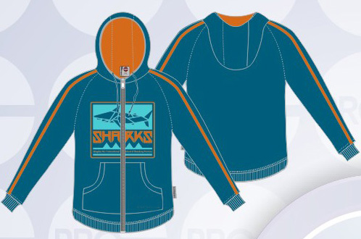
Weekly Activities: 08/22/2016-08/26/2016 Grade 7: Game Play-Volleyball & Swim Grade 8: Game Play-Volleyball & Swim HS PE 1&2: Game Play-Volleyball & Swim General News: 1. Swimming will begin on Wednesday! 2. Soccer Camp Sign-ups are still going! 3. ASAP has started! 4. Varsity Volleyball practice this week! 5. Middle School Soccer practice this week!! 6. Order QISS Spirit Wear by Sept. 5th Things to bring: 1. Comfortable PE Attire: Shoes, shorts/Pants, T-shirt/Long sleeve shirt 2. Bring a change of clothes to each class to earn full points 3. Swimming: Goggles, Swim Suit, Swim Cap, and Towel Homework and Assignments: *Volleyball Assessment due Friday on Edmodo!
PE Newsletter # 2
Action Shot of the Week:
Go Sharks!!!!

Slide 3
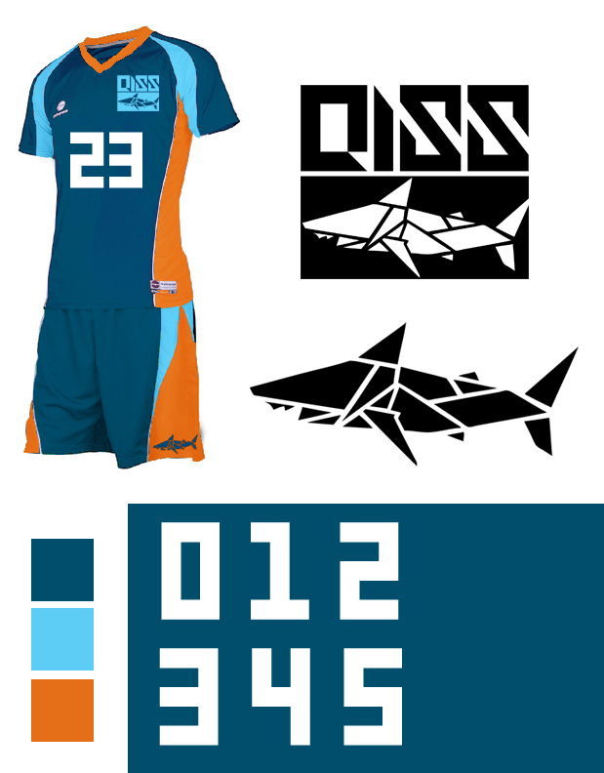
Weekly Activities: 08/29/2016-09/02/2016 Grade 7: Swimming- Freestyle and Back Grade 8: Swimming- Freestyle and Back HS PE 1&2: Swimming- Freestyle and Back General News: 1. Swimming will continue this week! 2. Soccer Camp Sign-ups are still going! 3. ASAP has started! 4. Varsity Volleyball practice this week! 5. Middle School Soccer practice this week!! 6. Order QISS Spirit Wear by Sept. 5th Things to bring: 1. Comfortable PE Attire: Shoes, shorts/Pants, T-shirt/Long sleeve shirt 2. Bring a change of clothes to each class to earn full points 3. Swimming: Goggles, Swim Suit, Swim Cap, and Towel Homework and Assignments: *Swimming Assessment
PE Newsletter # 3
Shot of the Week:
Spirit Wear

Slide 4
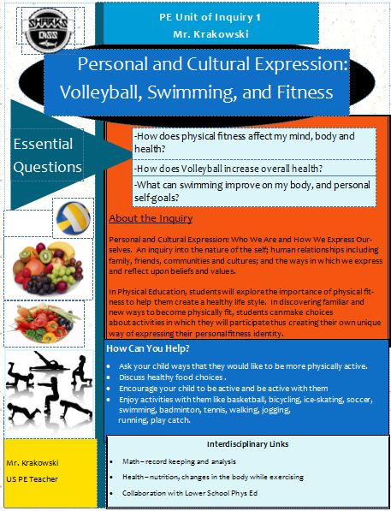
Weekly Activities: 09/05/2016-09/09/2016 Grade 7: Swimming- Breast and Testing Grade 8: Swimming- Breast and Testing HS PE 1&2: Swimming-Breast and Testing General News: 1. Swimming will continue this week! 2. Soccer Camp Sign-ups are finished! 3. ASAP has started! 4. Varsity Volleyball game this Friday! 5. Middle School Soccer practice this week!! 6. Order QISS Spirit Wear is done for now! Things to bring: 1. Comfortable PE Attire: Shoes, shorts/Pants, T-shirt/Long sleeve shirt 2. Bring a change of clothes to each class to earn full points 3. Swimming: Goggles, Swim Suit, Swim Cap, and Towel Homework and Assignments: *Swimming Assessment on Edmodo
PE Newsletter # 4
Shot of the Week:
Inquiry:

Slide 5
Weekly Activities: 09/12/2016-09/14/2016 Grade 7: Swimming- Breast and Testing Grade 8: Swimming- Breast and Testing HS PE 1&2: Swimming-Breast and Testing General News: 1. Last week for swimming!! 2. ACAMIS Varsity Volleyball Underway!! 3. ASAP will continue this week! 4. Varsity Volleyball game September 12! 5. Middle School Soccer practice this week!! 6. No school Thursday and Friday! Things to bring: 1. Comfortable PE Attire: Shoes, shorts/Pants, T-shirt/Long sleeve shirt 2. Bring a change of clothes to each class to earn full points 3. Swimming: Goggles, Swim Suit, Swim Cap, and Towel Homework and Assignments: *No Homework
PE Newsletter # 5
Shot of the Week:
Inquiry:

Slide 6
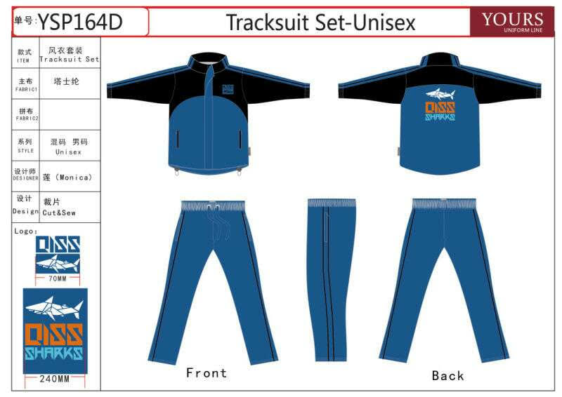
Weekly Activities: 09/19/2016-09/22/2016 Grade 7: Swimming- Swim Test Grade 8: Swimming- Swim Test HS PE 1&2: Swimming- Swim Test General News: 1. Last week for swimming!! 2. ACAMIS Varsity Volleyball Underway!! 3. ASAP will continue this week! 4. Staff Game Thursday for Volleyball! 5. Middle School Soccer practice this week!! 6. No school Friday! Things to bring: 1. Comfortable PE Attire: Shoes, shorts/Pants, T-shirt/Long sleeve shirt 2. Bring a change of clothes to each class to earn full points 3. Swimming: Goggles, Swim Suit, Swim Cap, and Towel Homework and Assignments: *No Homework
PE Newsletter # 6
Shot of the Week:
ACAMIS Jackets:

Slide 7
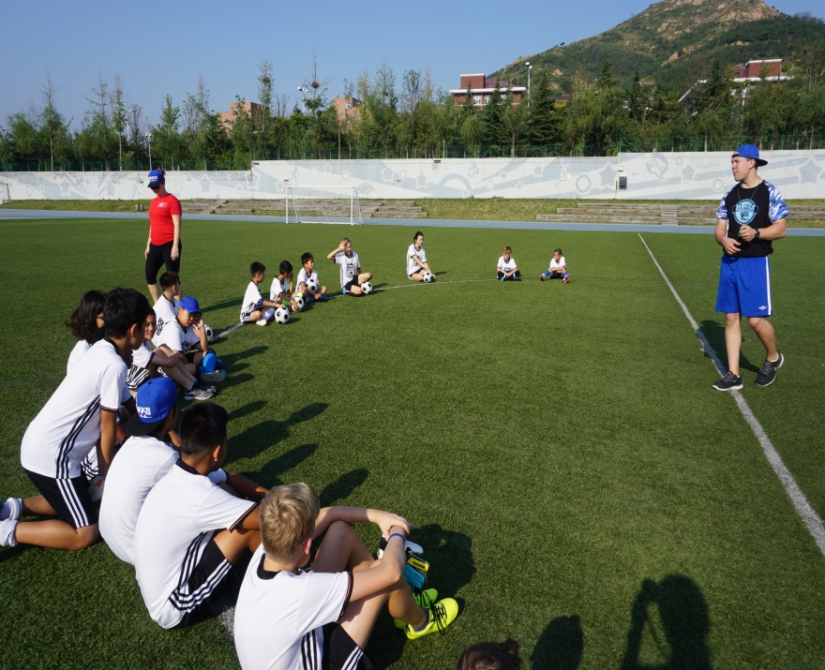
Weekly Activities: 09/26/2016-09/30/2016 Grade 7: Fitness Testing Grade 8: Fitness Testing HS PE 1&2: Fitness Testing General News: 1. Fitness Testing this week!! 2. ACAMIS Varsity Volleyball Underway!! 3. ASAP will continue this week! 4. No Games this week! 5. Middle School Soccer practice this week!! 6. Enjoy your Holiday Break! Things to bring: 1. Comfortable PE Attire: Shoes, shorts/Pants, T-shirt/Long sleeve shirt 2. Bring a change of clothes to each class to earn full points 3. Swimming: Goggles, Swim Suit, Swim Cap, and Towel Homework and Assignments: *No Homework
PE Newsletter # 7
Shot of the Week:
Soccer Camp

Slide 8
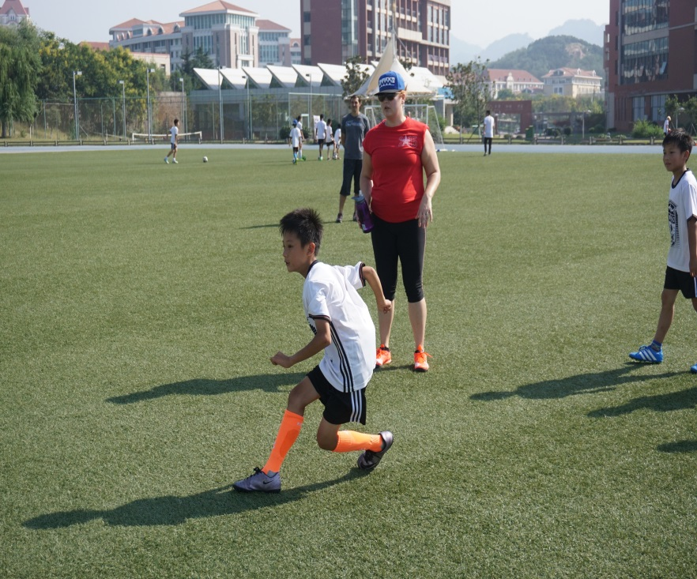
Weekly Activities: 10/10/2016-10/14/2016 Grade 7: Tennis-Striking Grade 8: Tennis-Striking HS PE 1&2: Tennis-Striking General News: 1. Welcome Back!! 2. ACAMIS Varsity Volleyball Underway!! 3. ASAP will continue this week! 4. No Games this week! 5. Middle School Soccer practice this week!! 6. Enjoy your Holiday Break! Things to bring: 1. Comfortable PE Attire: Shoes, shorts/Pants, T-shirt/Long sleeve shirt 2. Bring a change of clothes to each class to earn full points 3. Swimming: Goggles, Swim Suit, Swim Cap, and Towel Homework and Assignments: *No Homework
PE Newsletter # 8
Shot of the Week:
Soccer Camp

Slide 9
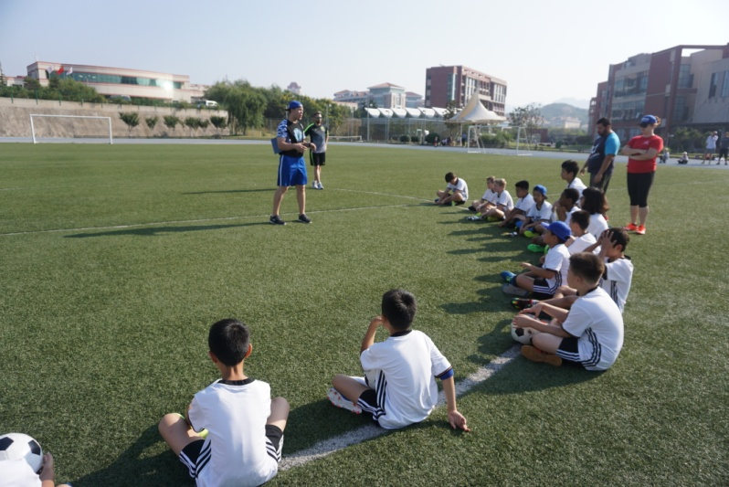
Weekly Activities: 10/17/2016-10/21/2016 Grade 7: Table Tennis- Forehand Grade 8: Table Tennis- Forehand HS PE 1&2: Table Tennis-Forehand General News: 1. Continue to Practice English Only!! 2. ACAMIS Varsity Volleyball this week!! 3. ASAP will continue this week! 4. Stay tuned for Games this week! 5. Middle School Soccer practice this week!! 6. Quarter 2 has begun! Things to bring: 1. Comfortable PE Attire: Shoes, shorts/Pants, T-shirt/Long sleeve shirt 2. Bring a change of clothes to each class to earn full points 3. Homework Assignments turned in on time please!
QISS Upper Physical Education Newsletter #9
Shot of the Week:
Soccer Camp

Slide 10
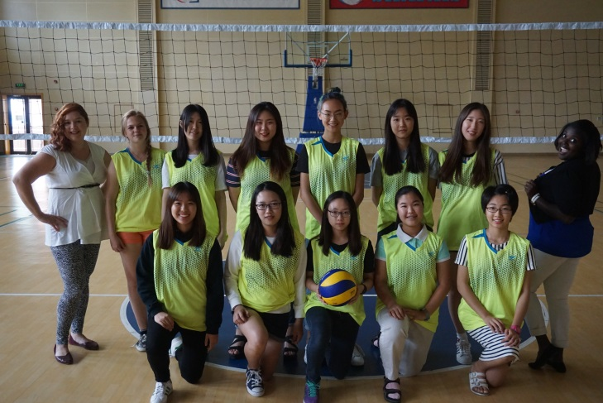
Weekly Activities: 10/24/2016-10/28/2016 Grade 7: Table Tennis- Forehand Grade 8: Table Tennis- Forehand HS PE 1&2: Table Tennis-Forehand General News: 1. Continue to Practice English Only!! 2. Varsity Volleyball this week!! 3. ASAP will continue this week! 4. QISN Middle School Soccer Tournament! 5. Middle School Soccer practice this week!! 6. Quarter 2 has begun! Things to bring: 1. Comfortable PE Attire: Shoes, shorts/Pants, T-shirt/Long sleeve shirt 2. Bring a change of clothes to each class to earn full points 3. Homework Assignments turned in on time please!
QISS Upper Physical Education Newsletter #10
Shot of the Week:
QISS Girl’s Volleyball

Slide 11
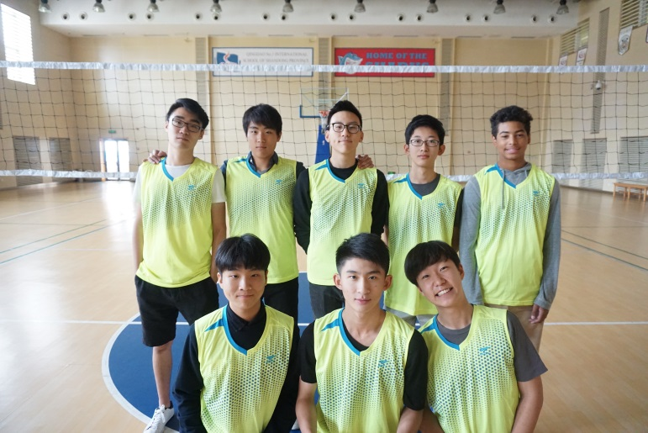
Weekly Activities: 10/31/2016-11/04/2016 Grade 7: Table Tennis- Game Play Grade 8: Table Tennis- Game Play HS PE 1&2: Table Tennis- Game Play General News: 1. Continue to Practice English Only!! 2. Varsity Volleyball acamis thursday!! 3. ASAP will continue this week! 4. QISN Middle School Soccer Practice! 5. SAT this saturday! Things to bring: 1. Comfortable PE Attire: Shoes, shorts/Pants, T-shirt/Long sleeve shirt 2. Bring a change of clothes to each class to earn full points 3. Homework Assignments turned in on time please!
QISS Upper Physical Education Newsletter #11
Shot of the Week:
QISS Boy’s Volleyball

Slide 12
Weekly Activities: 11/07/2016-11/11/2016 Grade 7: Floor hockey- dRIBBLING Grade 8: Floor hockey- dRIBBLING HS PE 1&2: Floor hockey- Dribbling General News: 1. Half Day on Wednesday!! 2. Varsity Volleyball has ended!! 3. ASAP will continue this week! 4. Basketball Tryout Monday November 14th! 5. International Day this Saturday! Things to bring: 1. Comfortable PE Attire: Shoes, shorts/Pants, T-shirt/Long sleeve shirt 2. Bring a change of clothes to each class to earn full points 3. Homework Assignments turned in on time please!
QISS Upper Physical Education Newsletter #12
Shot of the Week:
Sharks!!

Slide 13
Weekly Activities: 11/14/2016-11/18/2016 Grade 7: Floor hockey- Passing Grade 8: Floor hockey- Passing HS PE 1&2: Floor hockey- Passing General News: 1. Last week for LRC!! 2. Varsity Basketball Tryouts this week! 3. ASAP end this week! 4. Thanksgiving next week! 5. Talent show Next Week! Things to bring: 1. Comfortable PE Attire: Shoes, shorts/Pants, T-shirt/Long sleeve shirt 2. Bring a change of clothes to each class to earn full points 3. Homework Assignments turned in on time please!
QISS Upper Physical Education Newsletter #13
Shot of the Week:
Sharks!!

Slide 14
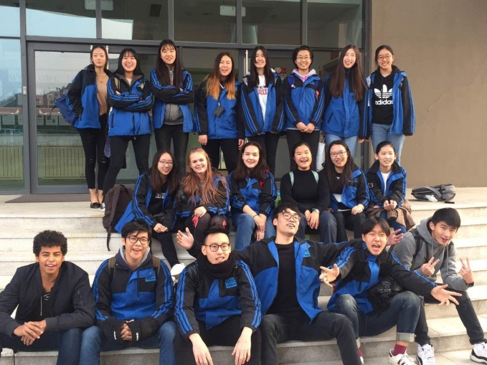
Weekly Activities: 11/21/2016-11/23/2016 Grade 7: Floor hockey- Shooting Grade 8: Floor hockey- Shooting HS PE 1&2: Floor hockey- Shooting/Key Assignment General News: 1. NO ASAP this Week!! 2. Varsity Basketball Practice begins! 3. Key Assignment in a few weeks! 4. Thanksgiving this week! 5. Talent show this Week! Things to bring: 1. Comfortable PE Attire: Shoes, shorts/Pants, T-shirt/Long sleeve shirt 2. Bring a change of clothes to each class to earn full points 3. Homework Assignments turned in on time please!
QISS Upper Physical Education Newsletter #14
Shot of the Week:
Sharks!!

Slide 15
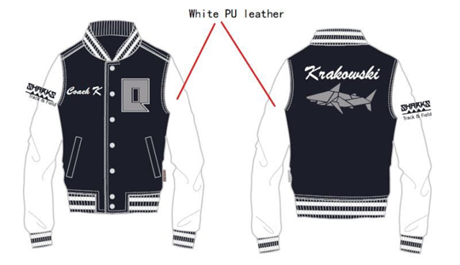
Weekly Activities: 11/28/2016-12/02/2016 Grade 7: Badminton Grade 8: Badminton HS PE 1&2: Badminton/ Key Assignment General News: 1. NO ASAP this Week!! 2. Varsity Basketball Game ! 3. Key Assignment in a few weeks! 4. SAT Saturday! 5. Winter Gala on December 10th! Things to bring: 1. Comfortable PE Attire: Shoes, shorts/Pants, T-shirt/Long sleeve shirt 2. Bring a change of clothes to each class to earn full points 3. Homework Assignments turned in on time please!
QISS Upper Physical Education Newsletter #15
Shot of the Week:
Spirit Wear!!

Slide 16
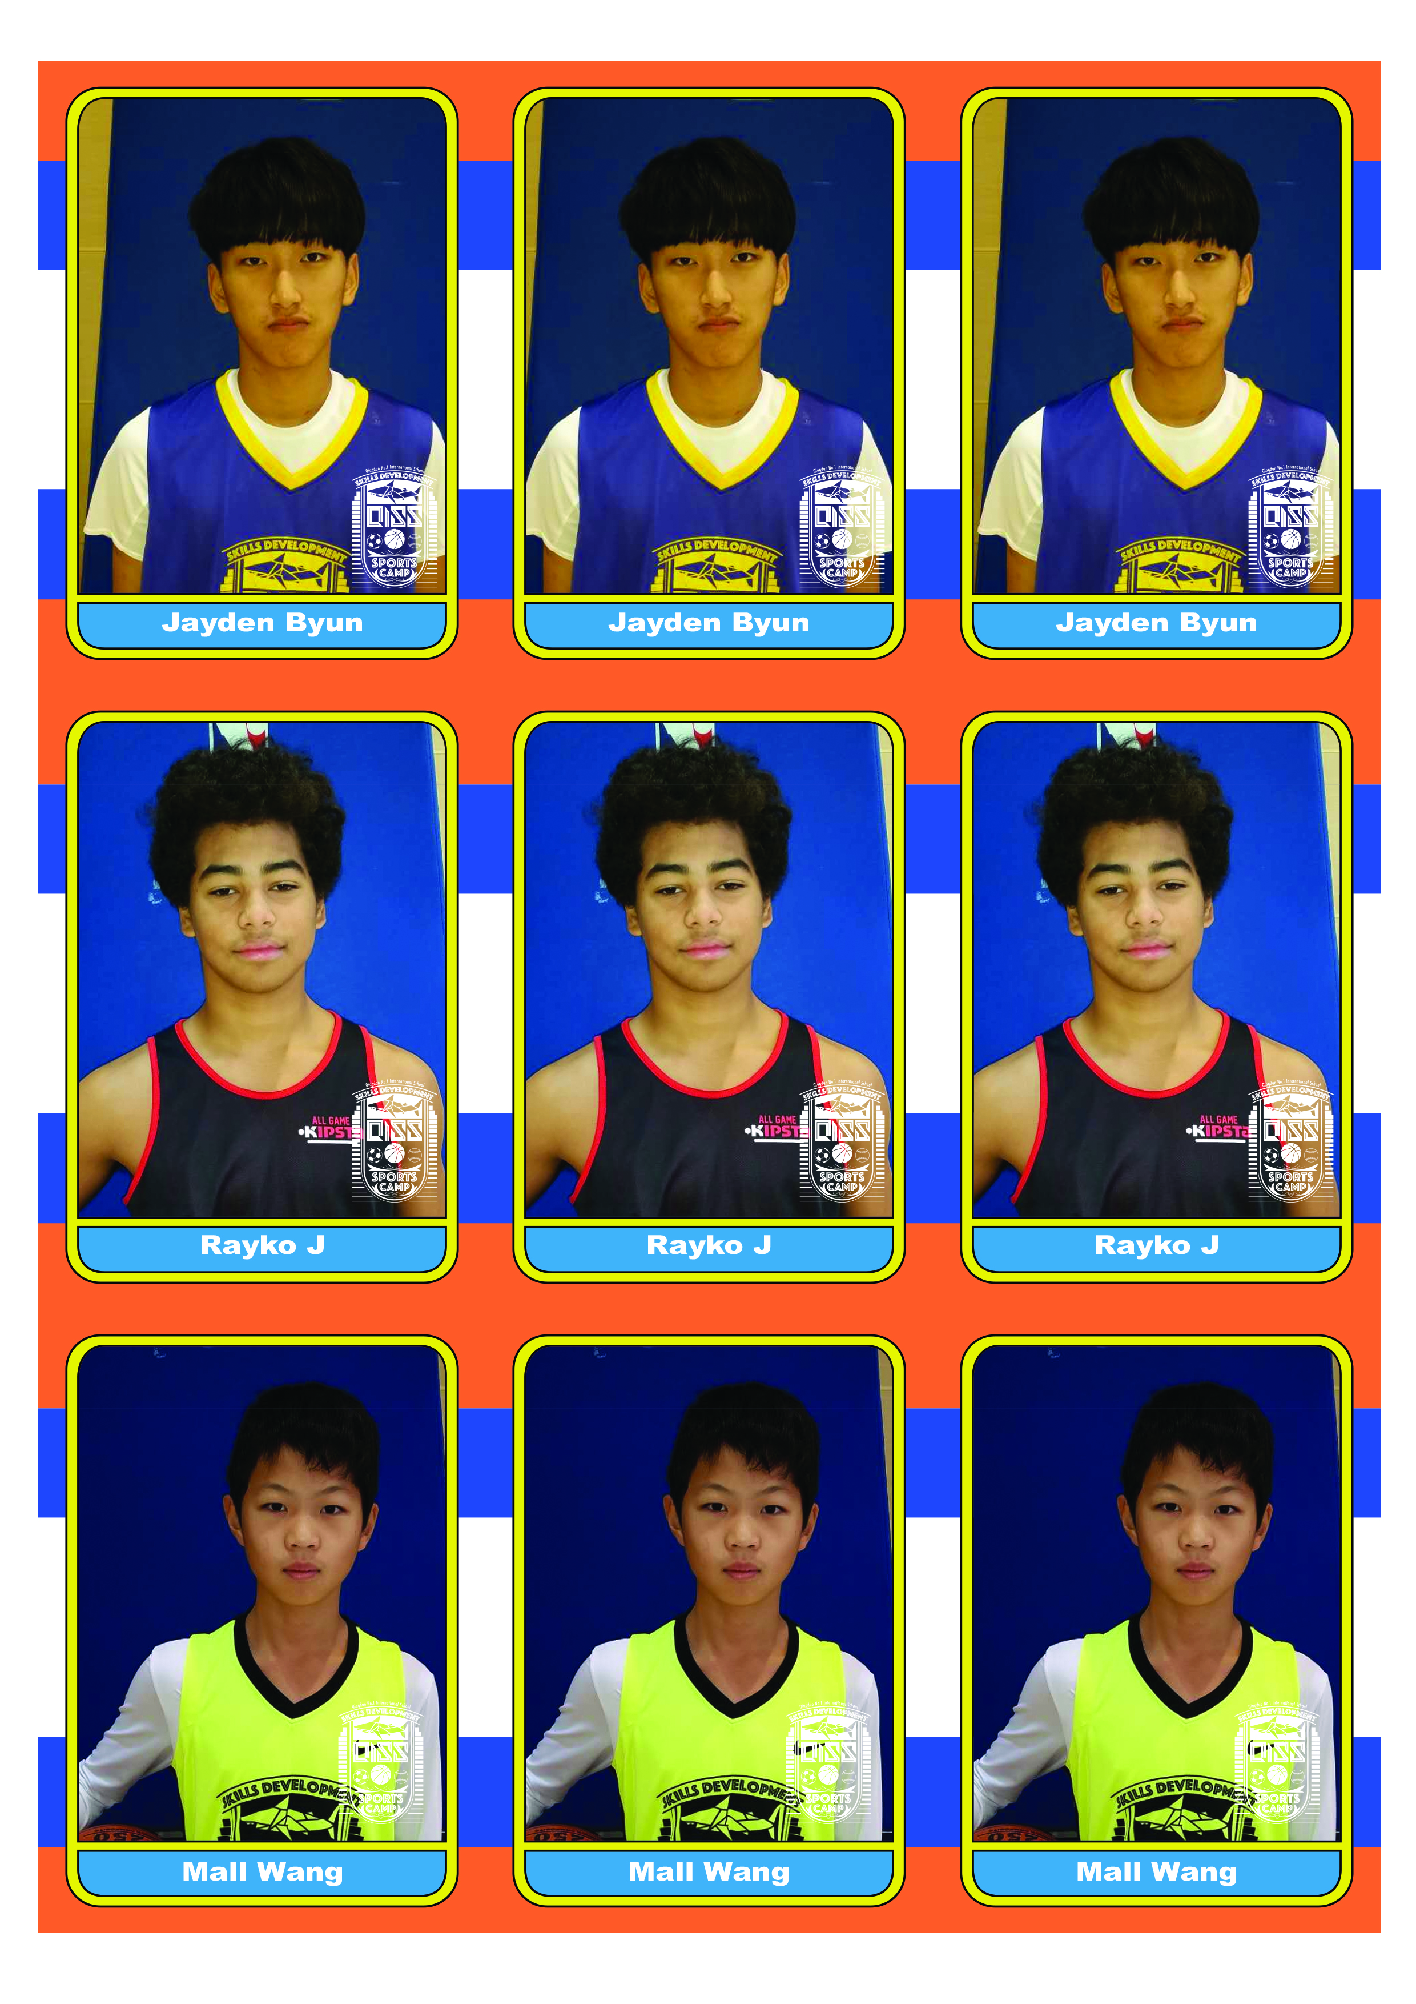
Weekly Activities: 12/05/2016-12/09/2016 Grade 7: Lacrosse Grade 8: Lacrosse HS PE 1&2: Key Assignment General News: 1. NO ASAP this Week!! 2. Varsity Basketball Game this Friday! 3. Key Assignment next week! 4. Vacation in 2 weeks! 5. Winter Gala on December 10th! Things to bring: 1. Comfortable PE Attire: Shoes, shorts/Pants, T-shirt/Long sleeve shirt 2. Bring a change of clothes to each class to earn full points 3. Homework Assignments turned in on time please!
QISS Upper Physical Education Newsletter #16
Shot of the Week:
Sport Cards!!

Slide 17
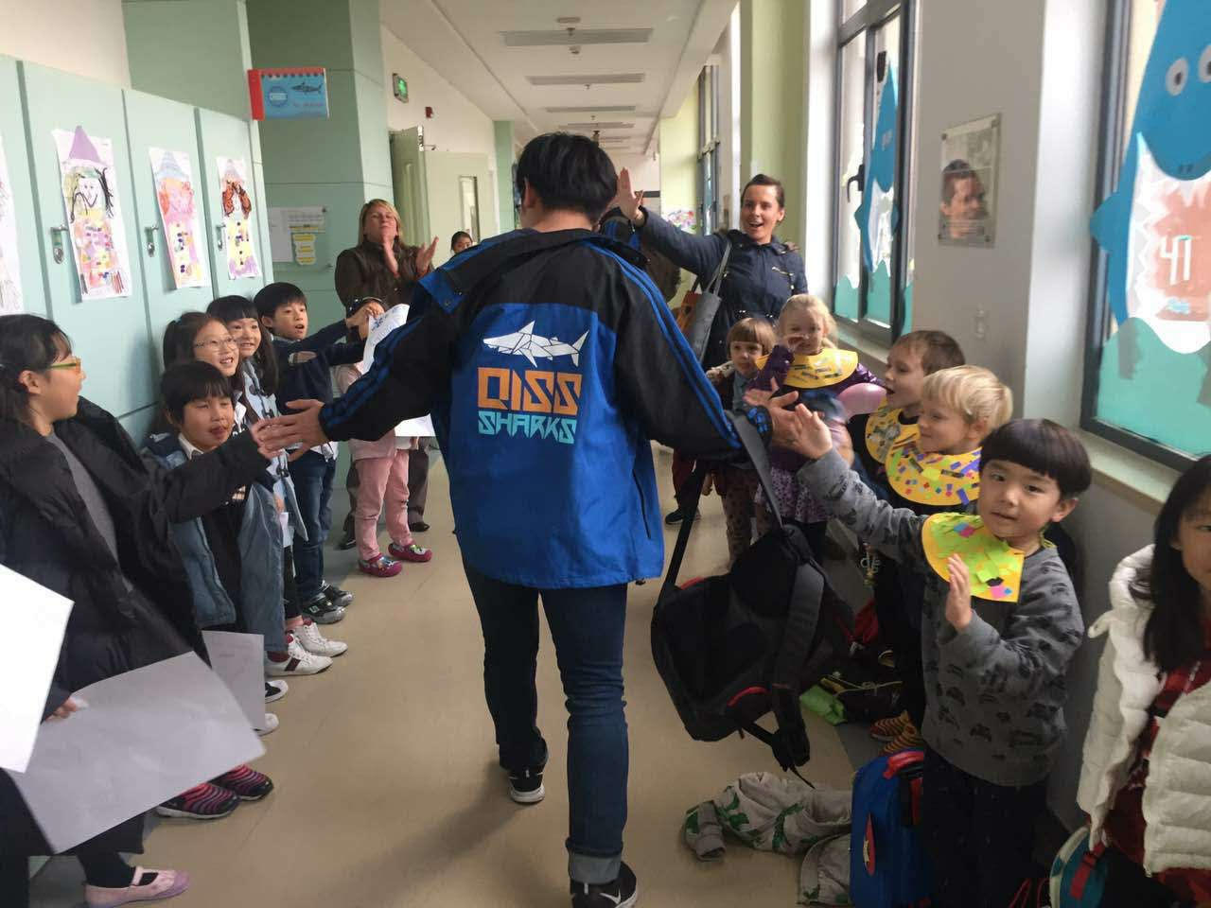
Weekly Activities: 12/12/2016-12/16/2016 Grade 7: Lacrosse Grade 8: Lacrosse HS PE 1&2: Key Assignment General News: 1. NO ASAP this Week!! 2. Varsity Basketball Game this Thursday vs ISQ! 3. Key Assignment Friday! 4. Merry Christmas! 5. See yeah Next Year! Things to bring: 1. Comfortable PE Attire: Shoes, shorts/Pants, T-shirt/Long sleeve shirt 2. Bring a change of clothes to each class to earn full points 3. Homework Assignments turned in on time please!
QISS Upper Physical Education Newsletter #17
Shot of the Week:
Sharks!!

Slide 18
QISS Upper Physical Education Newsletter #18
Weekly Activities: 1/9/2017-1/13/2017 Grade 7: Fitness Testing HS PE 1&2: Fitness Testing Nutrition and Wellness- Alcohol Unit General News: 1. Welcome Back!! 2. Varsity Basketball Practice this Week! 3. Spirit Wear will be handed out this Week! 4. China Day on February 25th! 5. QISS is starting a QISS Golf Team this Spring. please sign-up!! Things to bring: 1. Comfortable PE Attire: Shoes, shorts/Pants, T-shirt/Long sleeve shirt 2. Bring a change of clothes to each class to earn full points 3. Homework Assignments turned in on time please!
Shot of the Week:
Sharks!!

Slide 19
QISS Upper Physical Education Newsletter #19
Weekly Activities: 1/16/2017-1/20/2017 Grade 7: Fitness Testing HS PE 1&2: Fitness Testing Nutrition and Wellness- Alcohol Unit General News: 1. Fitness Testing this Week! 2. Varsity Basketball Games, Mon, Wed, and Thurs! 3. Spirit Wear Last order will go out after break! 4. China Day on February 25th! 5. QISS is starting a QISS Golf Team this Spring. please sign-up!! Things to bring: 1. Comfortable PE Attire: Shoes, shorts/Pants, T-shirt/Long sleeve shirt 2. Bring a change of clothes to each class to earn full points 3. Homework Assignments turned in on time please!
Shot of the Week:
Sharks!!

Slide 20
QISS Upper Physical Education Newsletter #20
Weekly Activities: 1/23/2017-1/26/2017 Grade 7: Basketball- Dribbling HS PE 1&2: Basketball- Expert Dribbling Nutrition and Wellness- Alcohol Part 2 General News: 1. China Day this wednesday! 2. Varsity Basketball Practice Mon,Tues,Wed,&Thurs!! 3. Spirit Wear Last order will go out after break! 4. ASAP will begin after break! 5. QISS is starting a QISS Golf Team this Spring. please sign-up!! Things to bring: 1. Comfortable PE Attire: Shoes, shorts/Pants, T-shirt/Long sleeve shirt 2. Bring a change of clothes to each class to earn full points 3. Homework Assignments turned in on time please!
Shot of the Week:
Sharks!!

Slide 21
QISS Upper Physical Education Newsletter #21
Weekly Activities: 2/13/2017-2/17/2017 Grade 7: Basketball- Shooting Drills HS PE 1&2: Basketball- Shooting for Dist. and Accur. Nutrition and Wellness- Alcohol Alcohol Continued General News: 1. Welcome BACK! 2. QISN Varsity Basketball Tournament this Week!! 3. Spirit Wear order goes out on Monday! 4. ASAP will Begin February 27th! 5. QISS is starting a QISS Golf Team this Spring. please sign-up!! 6. Sign-up for Baseball Camp Things to bring: 1. Comfortable PE Attire: Shoes, shorts/Pants, T-shirt/Long sleeve shirt 2. Bring a change of clothes to each class to earn full points 3. Homework Assignments turned in on time please!
Shot of the Week:
Sharks!!

Slide 22
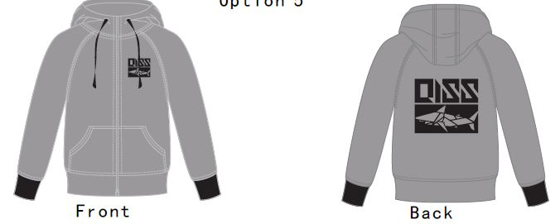
QISS Upper Physical Education Newsletter #22
Weekly Activities: 2/20/2017-2/24/2017 Grade 7: Basketball- Review HS PE 1&2: Basketball- Review
Nutrition and Wellness- Alcohol Presentations General News: 1. Girls QISN Champions and Boys 3rd Place, Congrats! 2. Soccer tryouts begins this week! 3. Spirit Wear order ends on March 1st! 4. ASAP will Begin February 27th! 5. QISS is starting a QISS Golf Team this Spring. please sign-up!! 6. Sign-up for Baseball Camp!! Things to bring: 1. Comfortable PE Attire: Shoes, shorts/Pants, T-shirt/Long sleeve shirt 2. Bring a change of clothes to each class to earn full points 3. Homework Assignments turned in on time please!
Shot of the Week:
Sharks!!

Slide 23
QISS Upper Physical Education Newsletter #23
Weekly Activities: 2/27/2017-3/03/2017 Grade 7: Soccer-Drills HS PE 1&2: Soccer- Extensions
Nutrition and Wellness- Alcohol Quiz, Tobacco Use General News: 1. Boys and Girls Soccer game on Tues vs Southlands! 2. ASAP Begins this week! 3. Spirit Wear order ends on March 1st! 4. Track and Field Begins Monday and Wednesday! 5. QISS Golf Team begins this Springs
6. Sign-up for Baseball Camp!! Things to bring: 1. Comfortable PE Attire: Shoes, shorts/Pants, T-shirt/Long sleeve shirt 2. Bring a change of clothes to each class to earn full points 3. Homework Assignments turned in on time please!
Shot of the Week:
ACAMIS!!

Slide 24
QISS Upper Physical Education Newsletter #24
Weekly Activities: 3/06/2017-3/10/2017 Grade 7: Soccer Games HS PE 1&2: Soccer- Extensions
Nutrition and Wellness- Cocaine and Heroin General News: 1. Boys on Thur and Girls Soccer game on Tues vs Isq! 2. ASAP continues this week! 3. Baseball Camp ends March 8th! 4. Track and Field PRACTICE Monday and Wednesday! 5. WASX Visit this week! Things to bring: 1. Comfortable PE Attire: Shoes, shorts/Pants, T-shirt/Long sleeve shirt 2. Bring a change of clothes to each class to earn full points 3. Homework Assignments turned in on time please!
Shot of the Week:
ACAMIS!!

Slide 25
QISS Upper Physical Education Newsletter #25
Weekly Activities: 3/20/2017-3/24/2017 Grade 7: Soccer Games HS PE 1&2: Soccer- Extensions
Nutrition and Wellness- Poster Presentations and TEST General News: 1. Boys on Thur and Girls Soccer game on Mon vs Isq! 2. ASAP continues this week! 3. Baseball Camp this Sunday! 4. Track and Field PRACTICE Monday and Wednesday! 5. ACAMIS Soccer in less than one month! Things to bring: 1. Comfortable PE Attire: Shoes, shorts/Pants, T-shirt/Long sleeve shirt 2. Bring a change of clothes to each class to earn full points 3. Homework Assignments turned in on time please!
Shot of the Week:
ACAMIS!!

Slide 26
QISS Upper Physical Education Newsletter #26
Weekly Activities: 3/27/2017-3/31/2017 Grade 7: Soccer Games HS PE 1&2: Soccer- Extensions
Nutrition and Wellness- Human Sexuality General News: 1. Boys and Girls Games all week! 2. ASAP continues this week! 3. Baseball Camp this Sunday, April 2nd! 4. Track and Field PRACTICE Monday and Wednesday! 5. Have a great Break! Things to bring: 1. Comfortable PE Attire: Shoes, shorts/Pants, T-shirt/Long sleeve shirt 2. Bring a change of clothes to each class to earn full points 3. Homework Assignments turned in on time please!
Shot of the Week:
Athletics!!

Slide 27
QISS Upper Physical Education Newsletter #27
Weekly Activities: 4/10/2017-4/14/2017 Grade 7: Baseball-Throwing HS PE 1&2: Baseball-Throwing for accuracy
Nutrition and Wellness- Human Sexuality General News: 1. QISN Soccer Tournament All Week! 2. ASAP continues this week! 3. Baseball Camp this Sunday April 16th! 4. Track and Field PRACTICE Monday and Wednesday! 5. ACAMIS Soccer next week! Things to bring: 1. Comfortable PE Attire: Shoes, shorts/Pants, T-shirt/Long sleeve shirt 2. Bring a change of clothes to each class to earn full points 3. Homework Assignments turned in on time please!
Shot of the Week:
Athletics!!

Slide 28
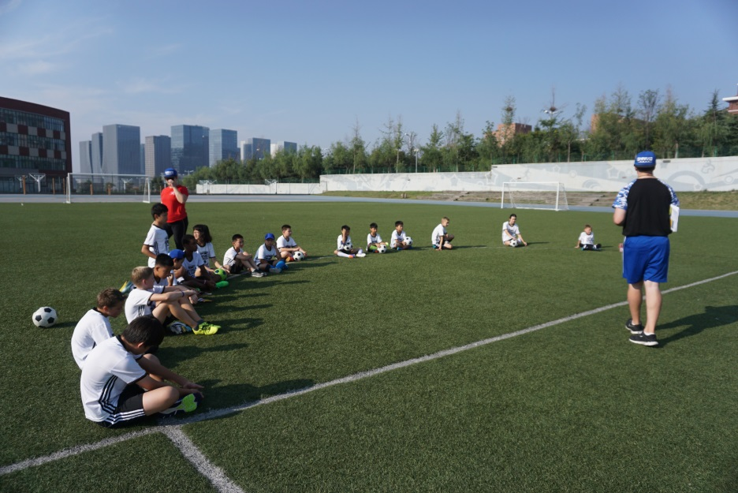
QISS Upper Physical Education Newsletter #28
Weekly Activities: 4/17/2017-4/21/2017 Grade 7: baseball- Hitting and Fielding HS PE 1&2: Soccer- Hitting and Fielding
Nutrition and Wellness- Human Sexuality General News: 1. ACAMIS Soccer Tournament this week! 2. ASAP continues this week! 3. Lower School Soccer starts in May 4. Track and Field PRACTICE Monday and Wednesday! 5. Athletic Dinner Tickets on Sale! Things to bring: 1. Comfortable PE Attire: Shoes, shorts/Pants, T-shirt/Long sleeve shirt 2. Bring a change of clothes to each class to earn full points 3. Homework Assignments turned in on time please!
Shot of the Week:
Athletics!!

Slide 29
QISS Upper Physical Education Newsletter #29
Weekly Activities: 4/24/2017-4/28/2017 Grade 7: baseball- Hitting and Fielding HS PE 1&2: Soccer- Hitting and Fielding
Nutrition and Wellness- Human Sexuality General News: 1. ACAMIS Soccer Tournament this week! 2. ASAP continues this week! 3. Lower School Soccer starts in May 4. Track and Field PRACTICE Monday and Wednesday! 5. Athletic Dinner Tickets on Sale! Things to bring: 1. Comfortable PE Attire: Shoes, shorts/Pants, T-shirt/Long sleeve shirt 2. Bring a change of clothes to each class to earn full points 3. Homework Assignments turned in on time please!
Shot of the Week:
Athletics!!

